Slide 1
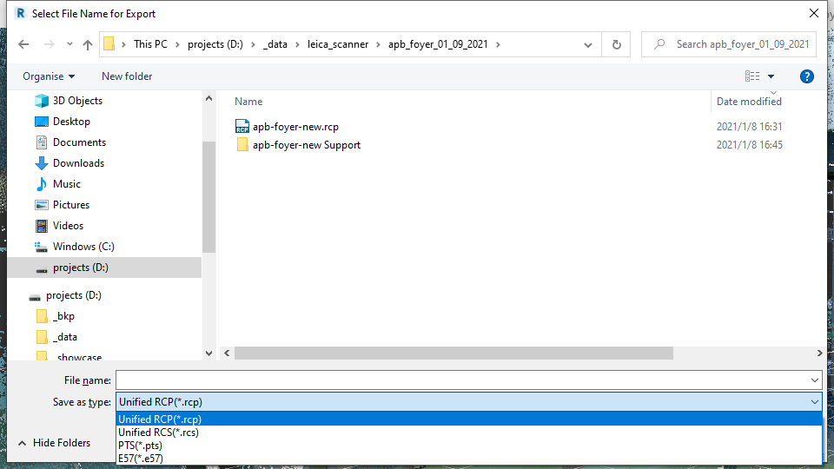
What do we get from the scanner?
Subsampled point cloud, in ASCII format
Can be opened by any txt editor (if not too large)
Compressed point cloud, contains camera position, but normal are not present for now.
The libe57 project provides a reader: http://www.libe57.org/
This has been ported to a python library: https://github.com/davidcaron/pye57

Slide 2

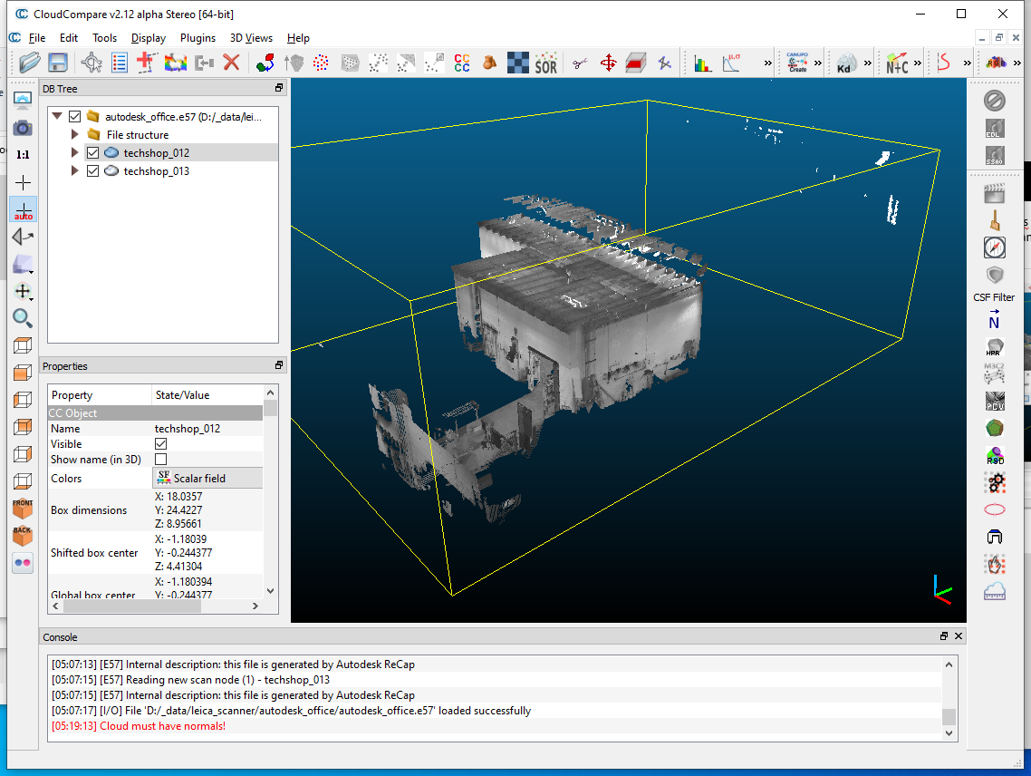
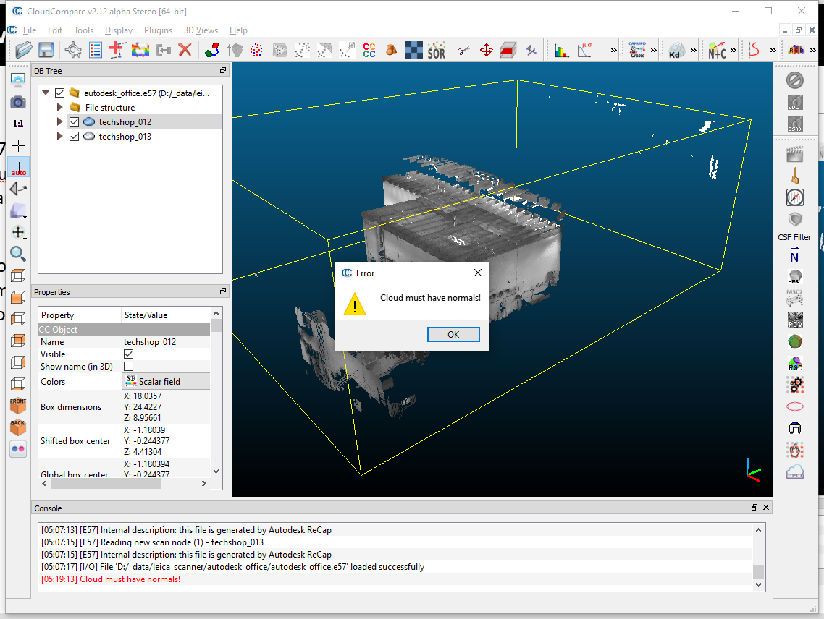
What do we get from the scanner?
.e57 file can be read to CloudCompare, and further cleaned/reconstructed.
-> A problem is that the normals are not computed, which is important for reconstruction algorithms.

Slide 3
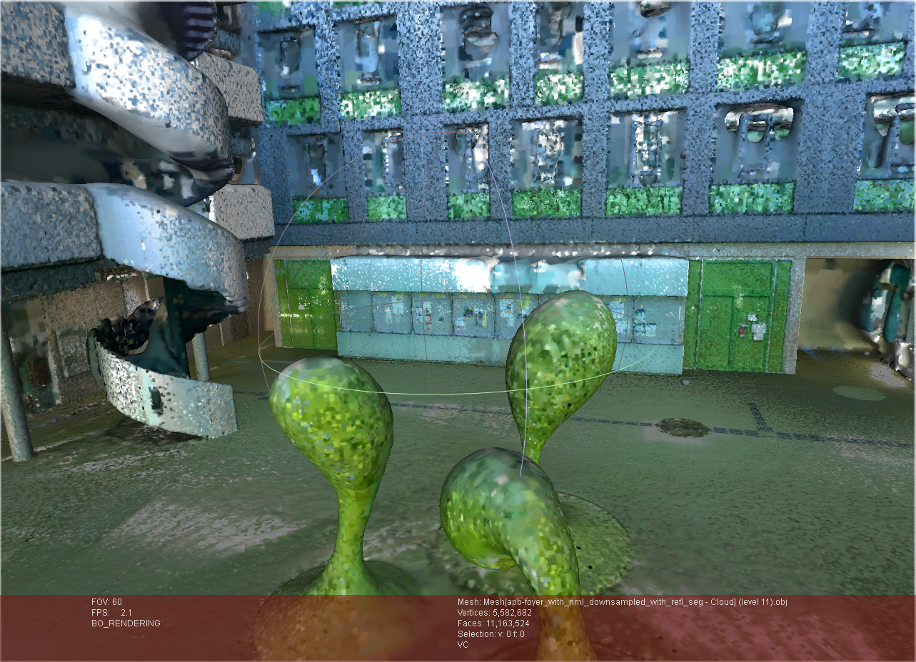
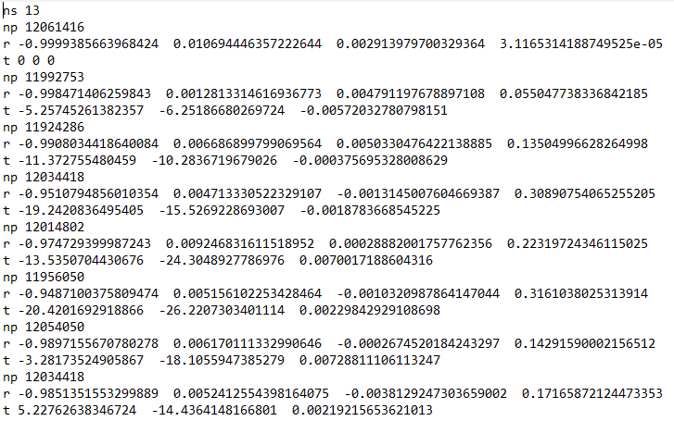
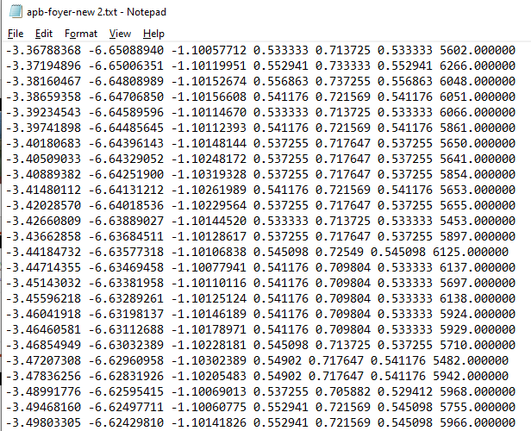
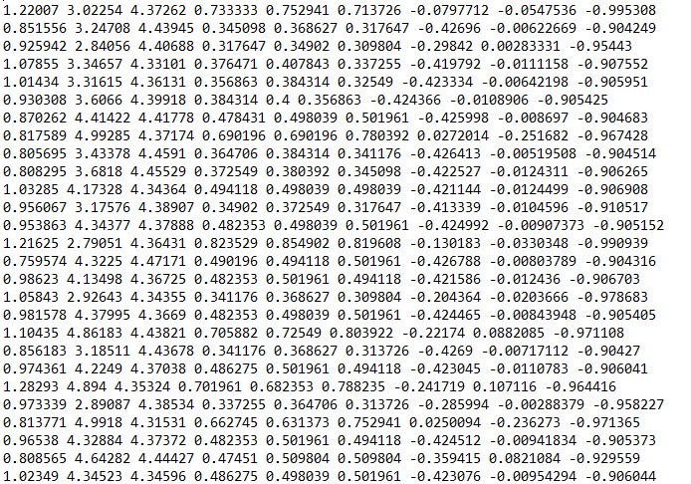
Normal computation
.campose file with https://github.com/davidcaron/pye57
.e57 file
Poisson Surface Reconstruction
list of .txt files
Point clouds with normal
position of the points
color of the points
CloudCompare
normal of the points

Slide 4
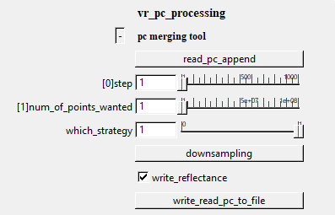
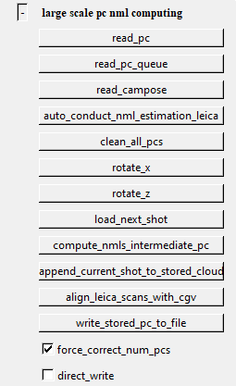
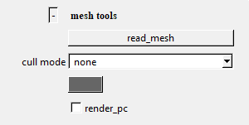
Normal computation
1. export .e57 file from the Autodesk Recap
2. Python scripts(you can find them here: https://github.com/yzyTUD/vr_pc_processing/tree/master/scripts) to extract a .campose file from .e57 file with
3. use CloudCompare(https://github.com/CloudCompare/CloudCompare) to
export point clouds to a .txt file, which is easier to read.
4. read to vr_pc_processing(https://github.com/yzyTUD/vr_pc_processing) and compute normals
5. load data with normals to CloudCompare or MeshLab, reconstruction​
Executable provided under exec/ folder
Usage is described by https://github.com/yzyTUD/vr_pc_processing/blob/master/usage/usage_description.mp4
[demo]

Slide 5
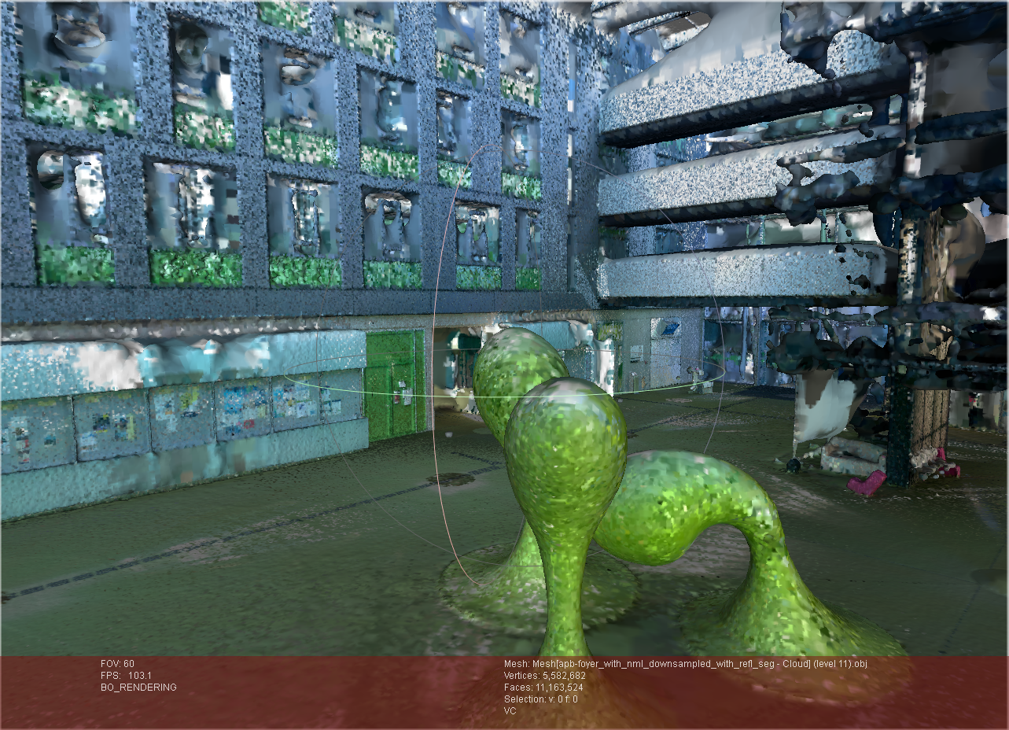
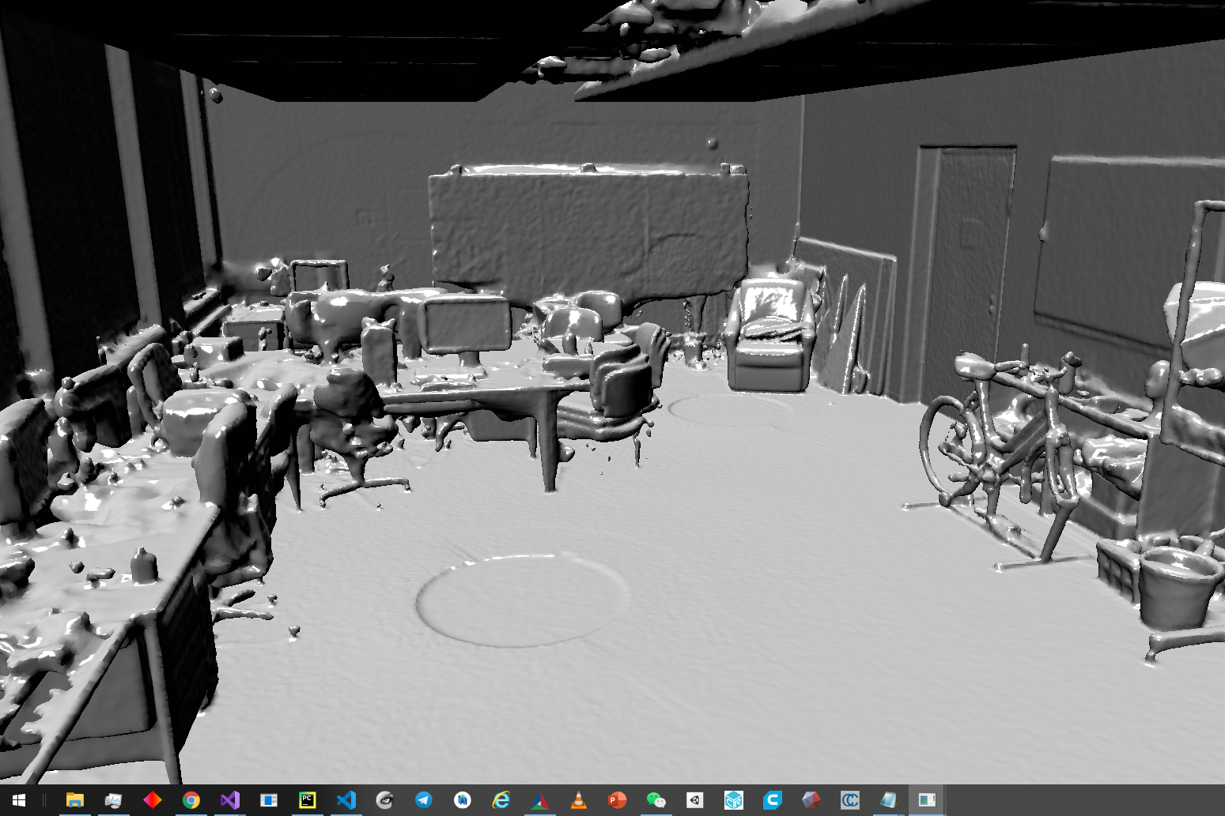
Some results
https://cloudstore.zih.tu-dresden.de/index.php/s/oZzgARppgPjgSFa
The generated Mesh[apb-foyer_with_nml_downsampled_with_refl_seg - Cloud] (level 11).obj
[demo]

Slide 6
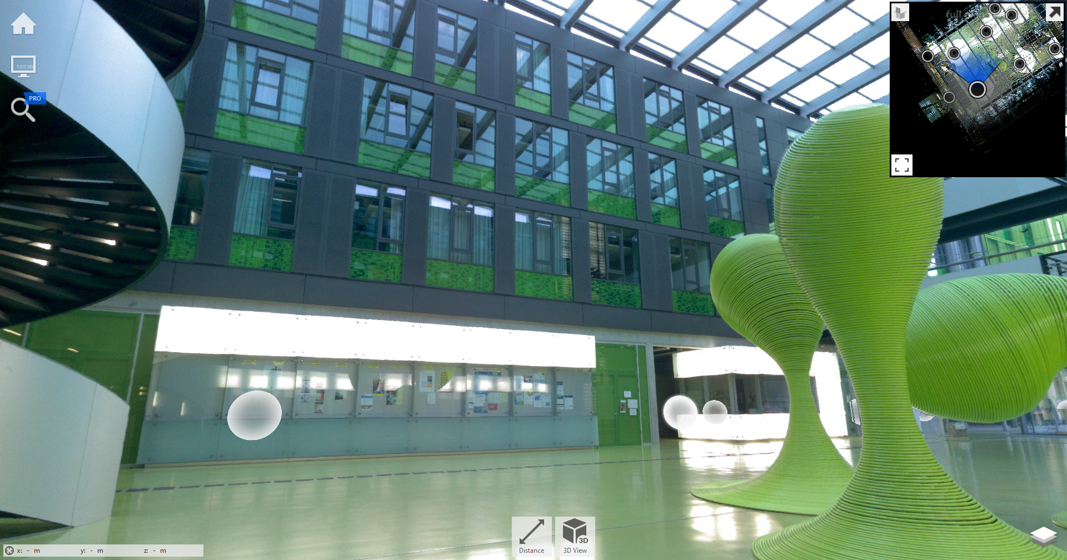
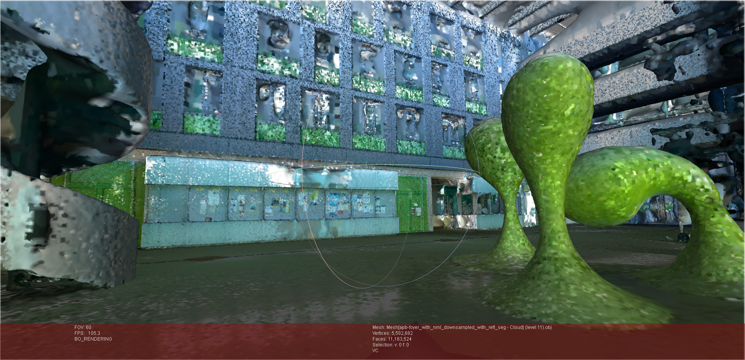
Works for students
“Photorealistic recreation”
Clean the point clouds with the CloudCompare or other similar software. [demo]
Try more reconstruction methods/software with the oriented point cloud (eg. MeshLab). [demo]
Improve the normal computing workflow, try other normal computing methods/software.
Clean the reconstructed mesh.
Render the reconstructed mesh efficiently/in a photorealistic way in VR.

Slide 7
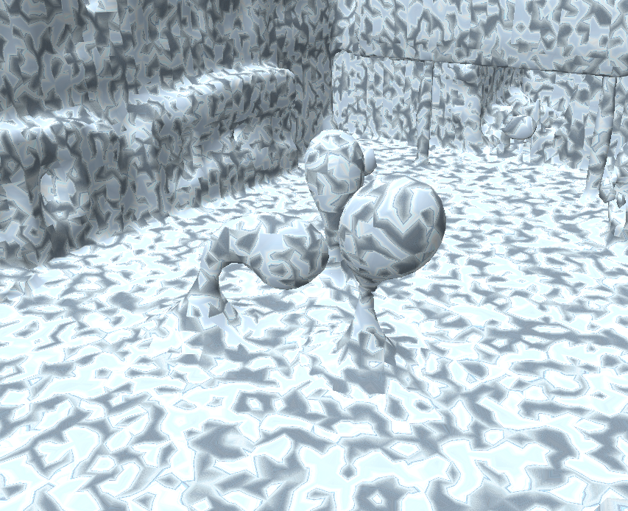
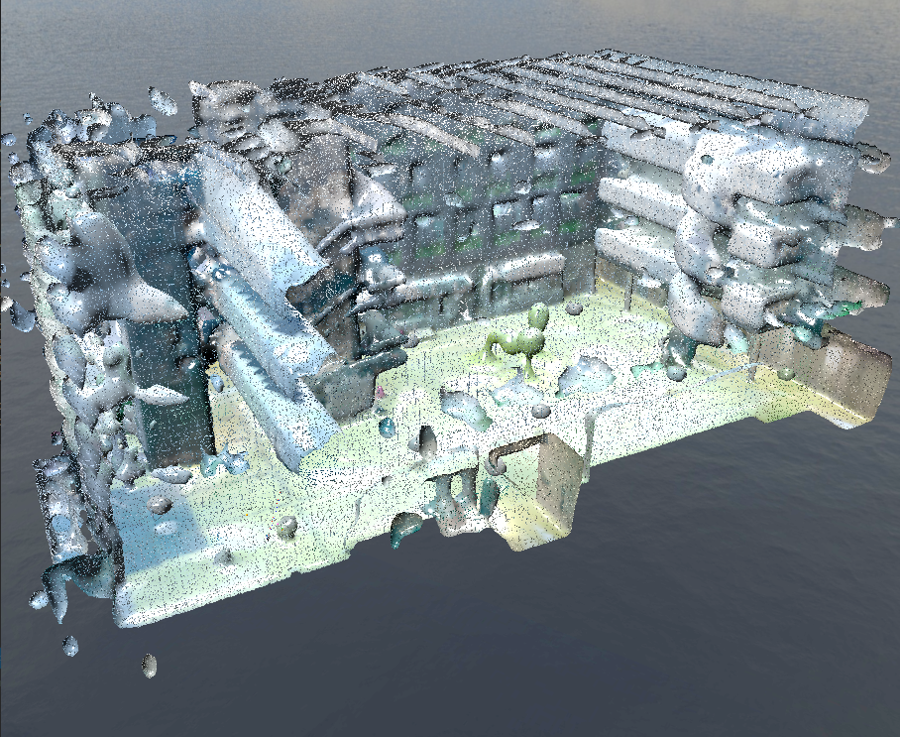
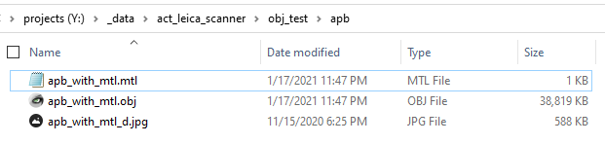
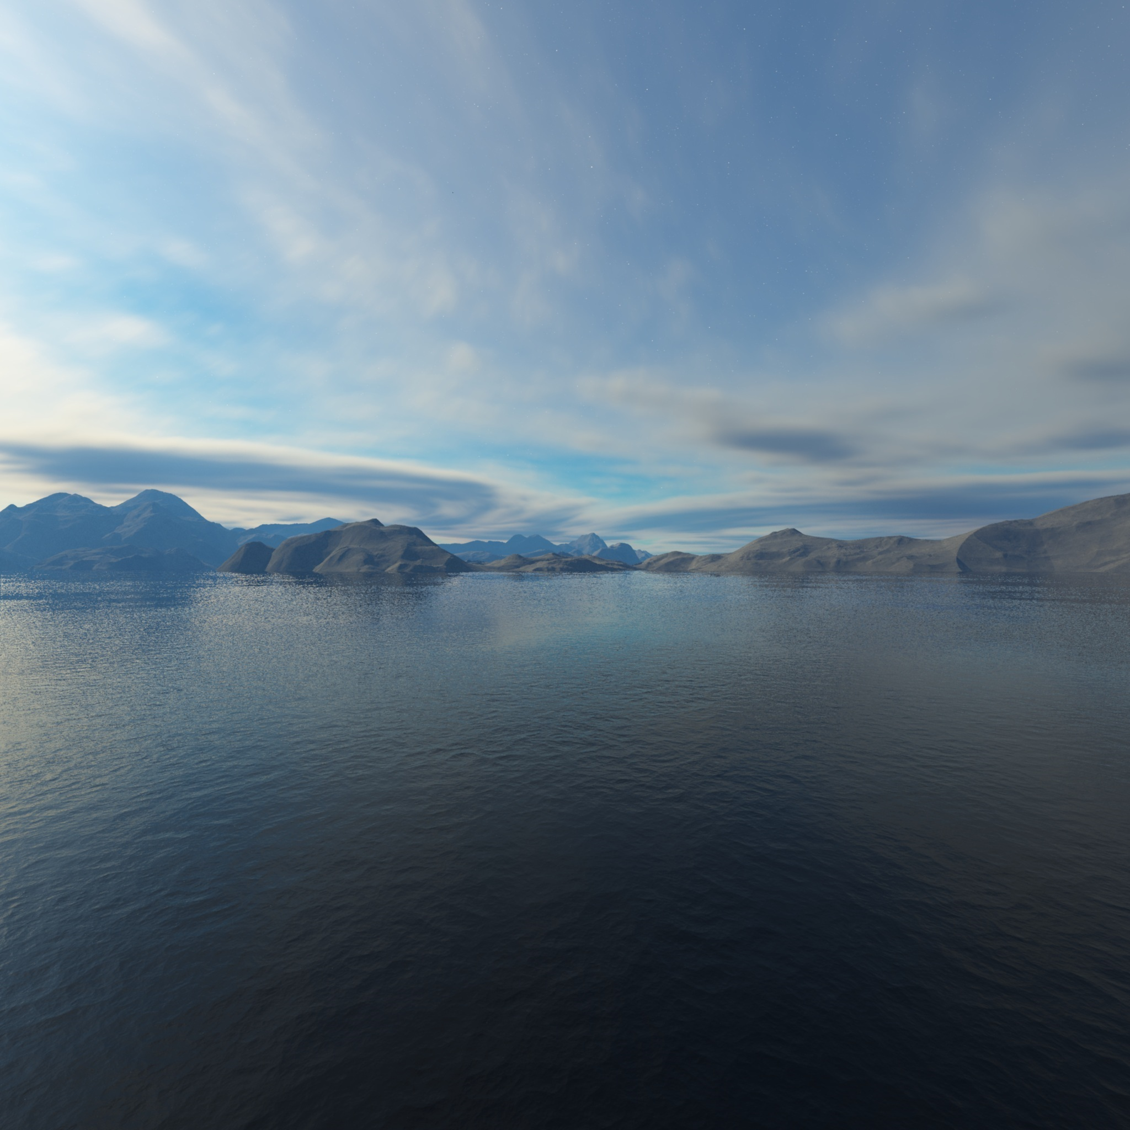
The computation of texture coordinates
Why?
Missing color information: per vertex shading not enabled in unity by default.
Map the best picture to the best geometry.
Solution:
Enable per vertex shading
not enabled by default
Tried to write a custom obj loader and a custom shader that pass the color directly to fragment shader, but this is a little bit complicated.
Texture coordinates computing and shading with textures
Generate random texture coordinates as a test
Extract panorama pictures from e57 file with python scripts, or from .rcp project
Compute correct coordinates with the help of camera positions

Slide 8
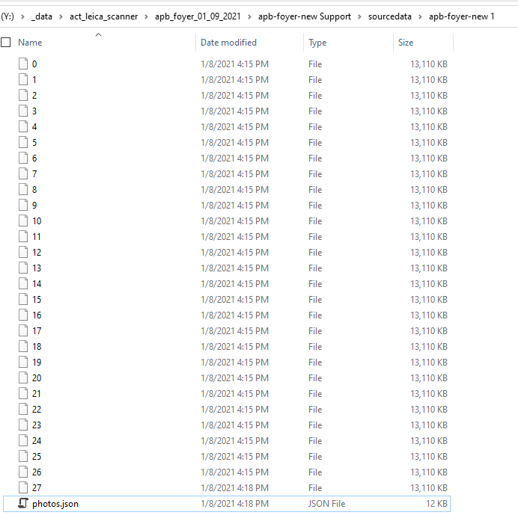
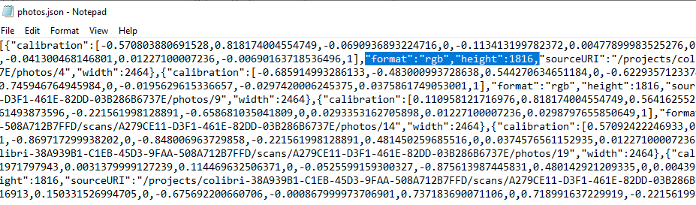
The computation of texture coordinates

Slide 9
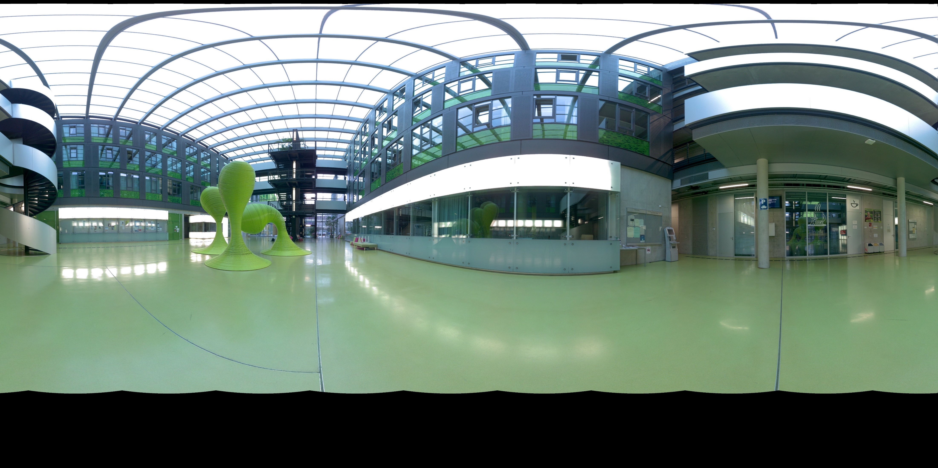
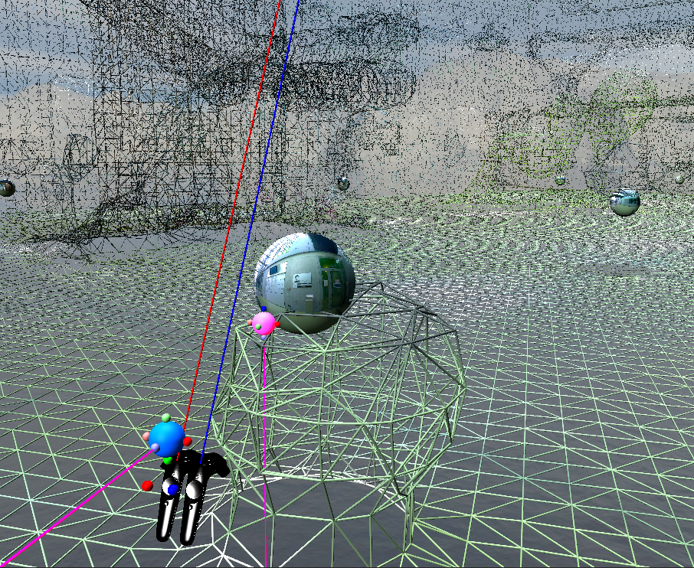
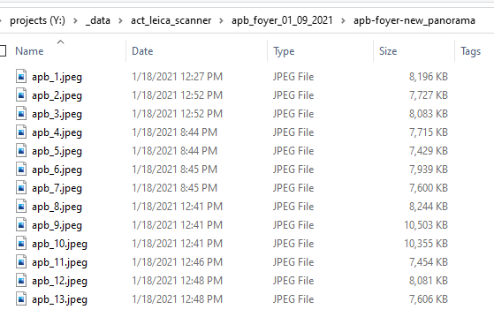
The computation of texture coordinates

Slide 10
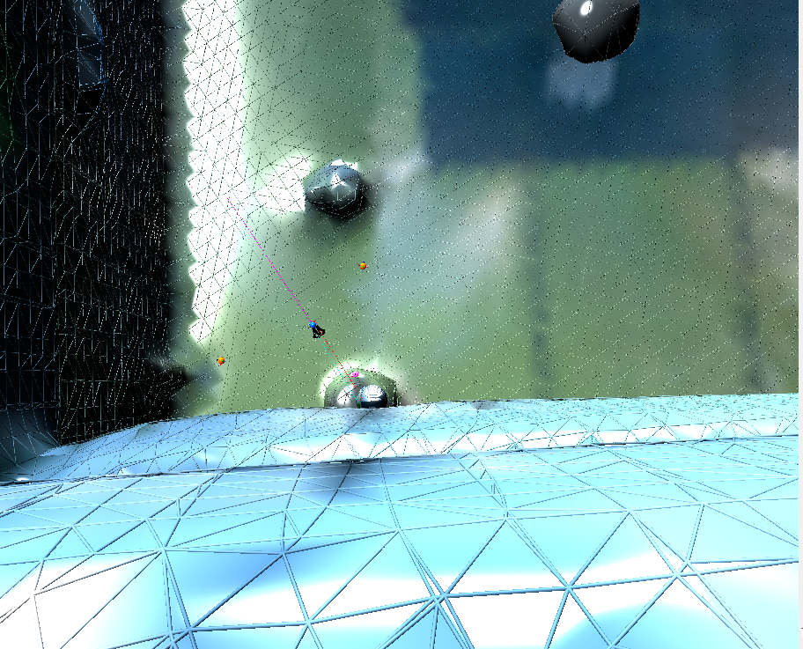
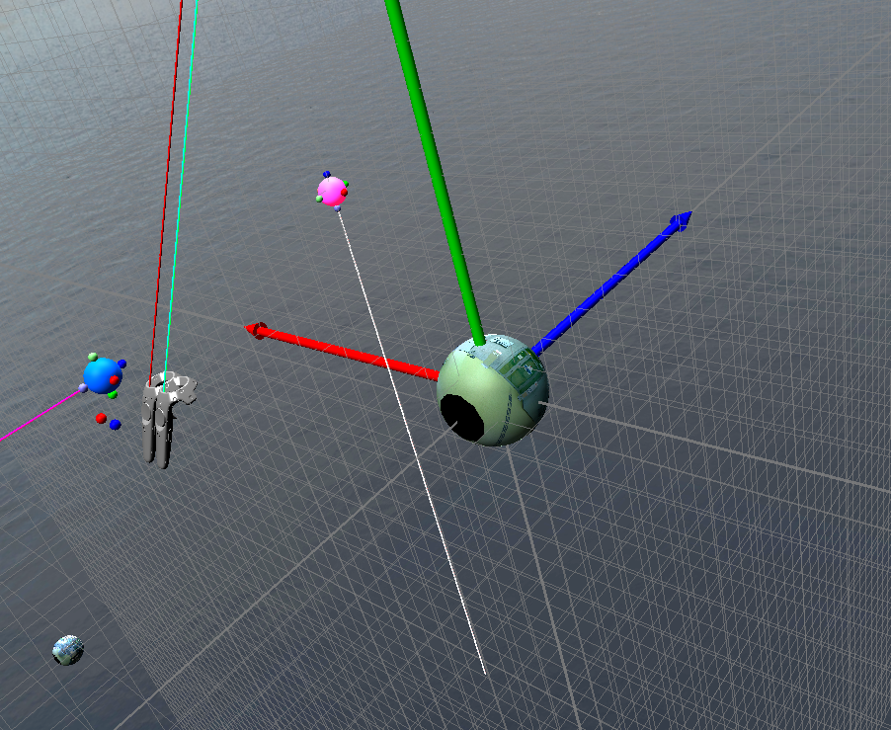
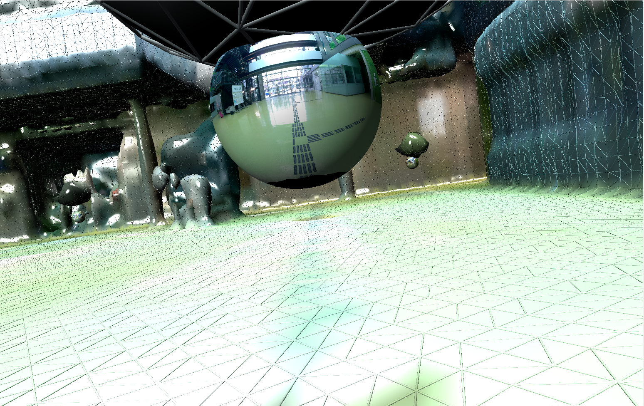
The computation of texture coordinates

Slide 11
The computation of texture coordinates
Next step:
Compute coordinates in human-centered mode
Output: textured model that can be load to any obj loader

Slide 12
Simplification/Fitting
A better spatial movement scheme implemented
Related to my master thesis: in progress

Slide 13
Realistic/Material

Slide 14
Some ideas/useful refernces
https://www.microsoft.com/en-us/research/blog/manipulating-space-time-mixed-reality/
http://www.cs.jhu.edu/~misha/MyPapers/SGP06.pdf
https://github.com/mkazhdan/PoissonRecon
https://www.youtube.com/watch?v=sv6T-tg6RL4&feature=youtu.be
https://github.com/sgumhold/cgv

